Slide 1
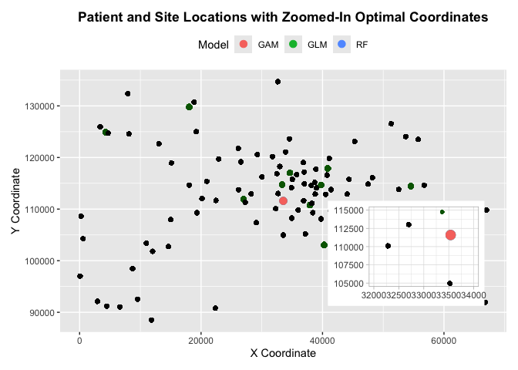
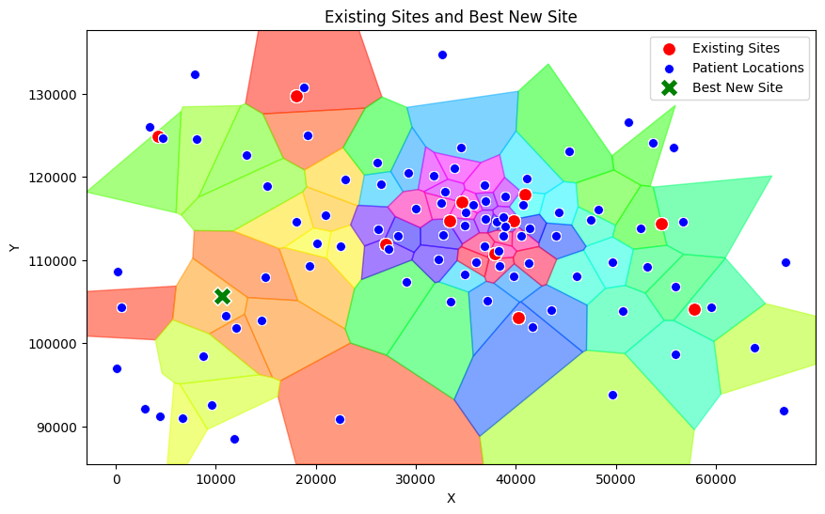
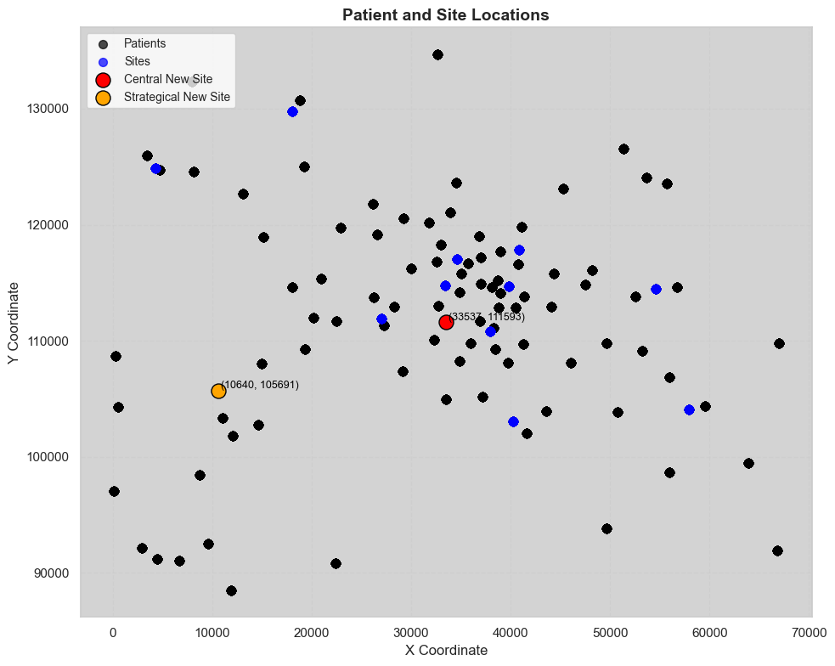
Business Report
Optimizing Accident & Emergency (A&E) Department Locations
Glauco Rampone, Camilla Andreozzi
University of Glasgow, Mathematics & Statistics
Introduction
This report presents the outcomes of the Undergraduate Operational Research Challenge for Public Health Scotland.
The project’s goal was to optimize the locations for one or more new A&E departments to address patient wait times effectively.
Two distinct solutions were identified, each focusing on a unique objective:
Centrally Located A&E Department (Heuristic Approach)
Strategically Located A&E Department (Empirical Approach)
Coordinates: (33537, 111593)
Coordinates: (10640, 105691)
Objective: Achieve a large total reduction in patient wait times and driving times in a specific high demand area.
Key Insights: Location was selected using Voronoi mapping and analysis of patient distribution. This solution addresses the overarching need for equitable healthcare access.
Key Metrics:
Average Wait Time Reduction: 13 minutes
Average Distance to Nearest A&E: 4,094 units.
Benefits: Enhances the overall equity of patient care. Provides targeted relief in high-demand areas.
Challenges: The model assumes that patients always choose the nearest department. Under this assumption, patients in the city center may not experience substantial benefits.
Objective: Reduce wait times and driving times for all patients uniformly across the region.
Key Insights: Location was selected using Linear, Poisson and Gamma models. It is designed to ease the pressure on all other departments.
Key Metrics:
Average Wait Time Reduction: 28 minutes
Average Distance to Nearest A&E: 4,243 units.
Benefits: Maximizes the system’s overall efficiency. Addresses system-wide inefficiencies.
Challenges: Works under the assumption that the main demand is concentrated in the center and habits will not change with a new department.
Combined Solutions
The combined solution involves the implementation of two departments. This approach integrates both system-wide efficiency and targeted relief.
Key Metrics:
Overall Average Wait Time Reduction: 40 minutes.
Overall Average Distance to Nearest A&E: 4,012 units.
Challenges: Increased initial investment and resource a location are required to establish two departments.
Benefits:
Balances system-wide efficiency with equity by providing both universal and targeted benefits.
Mitigates the limitations of individual models, ensuring benefits reach both centralized and peripheral patient populations.
Promotes a resilient healthcare system by accommodating potential future changes in patient distribution and demand patterns.

